Slide 1
Forecasting –gold price prediction
Progress meeting-2
Shyam prasad s
Pavithra
Floyd Fernandes
Anusha
Jaya
Shalini

Slide 2

Objective
The objective of the analysis is to create a model to analyze and predict the trend of the prices of gold.

Slide 3
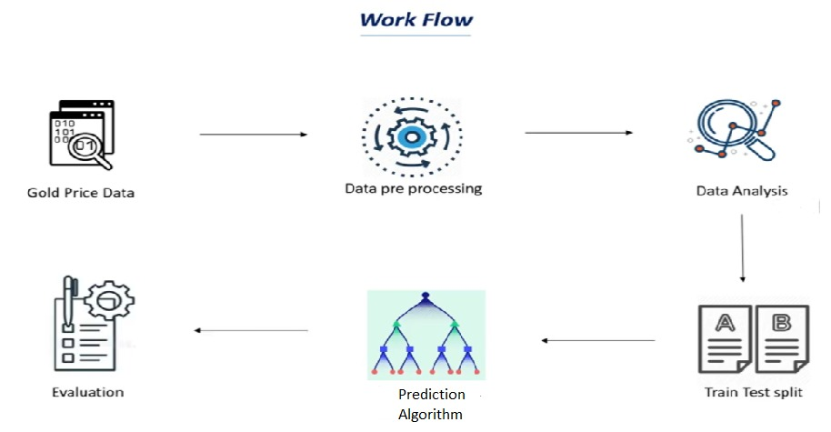
Project flow

Slide 4
Data analysis
Provided data was time series data where the gold prices were given from 1968 to 2021
Gold prices are increasing exponentially with respective to the time in the given data
The given data provides the price per ounce of gold

Slide 5
Data analysis
The given data consists do have missing values in the gold price column
By interpolating method the average has been calculated and filled in the missing values
Further data set has been taken forward to Exploratory Data Analysis

Slide 6
Data analysis
The data set is further subjected to the visualisation
By using plotting library matplotlib data has been analysed

Slide 7
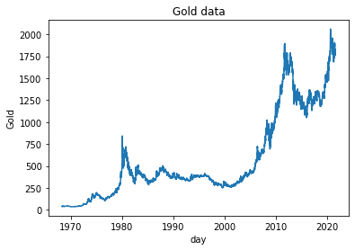
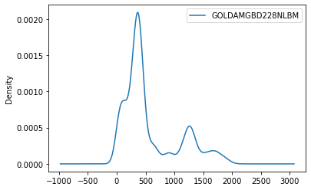
Visualizations

Slide 8
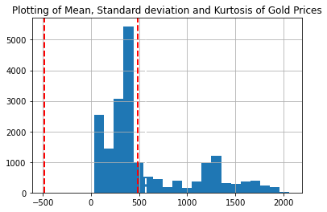
Mean= 573.298974601952
Standard Deviation= 485.27909922382423
Kurtosis= 0.09644041582980822

Slide 9
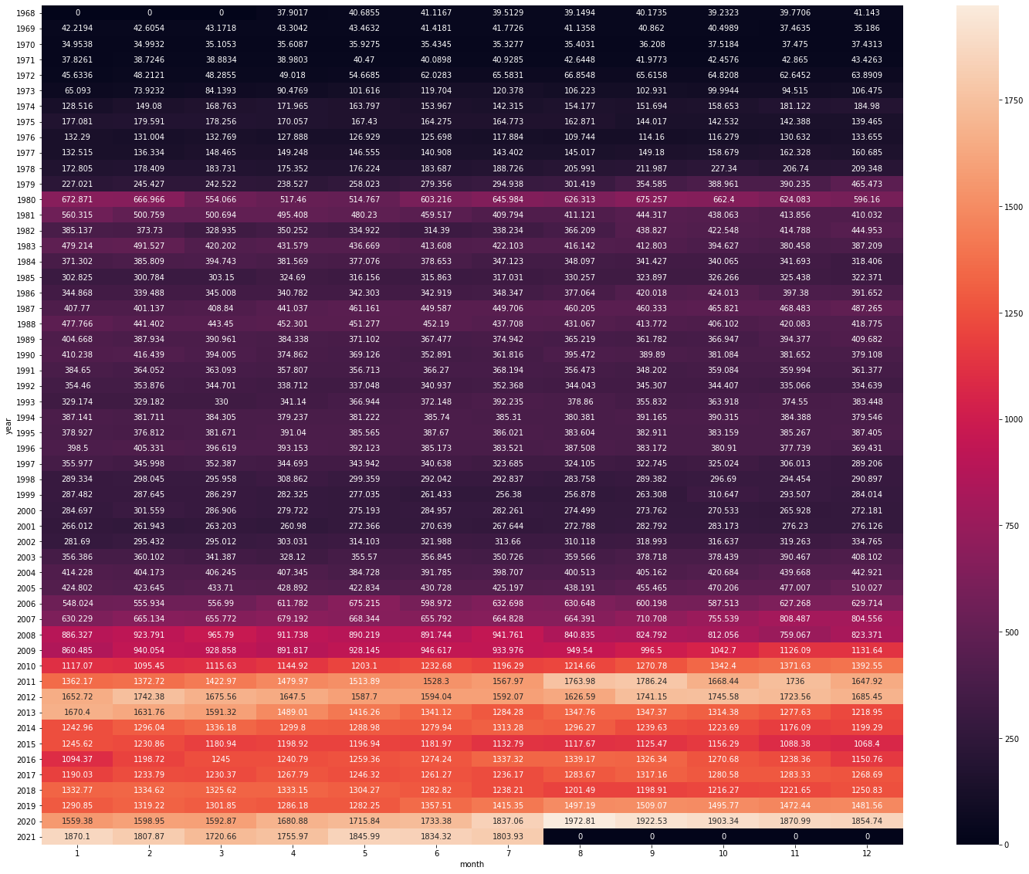

Slide 10
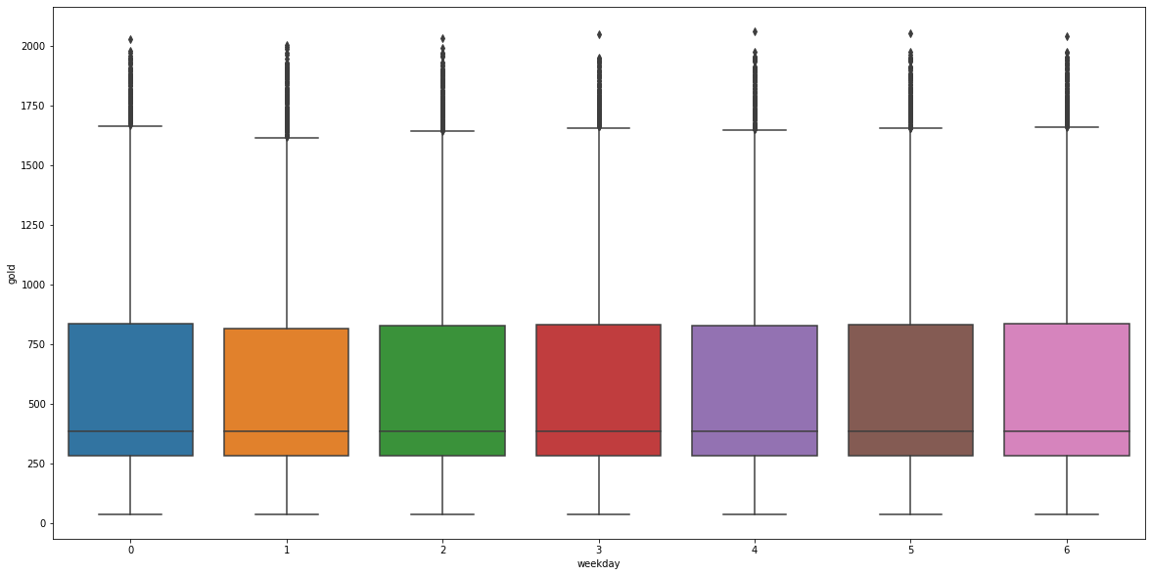

Slide 11
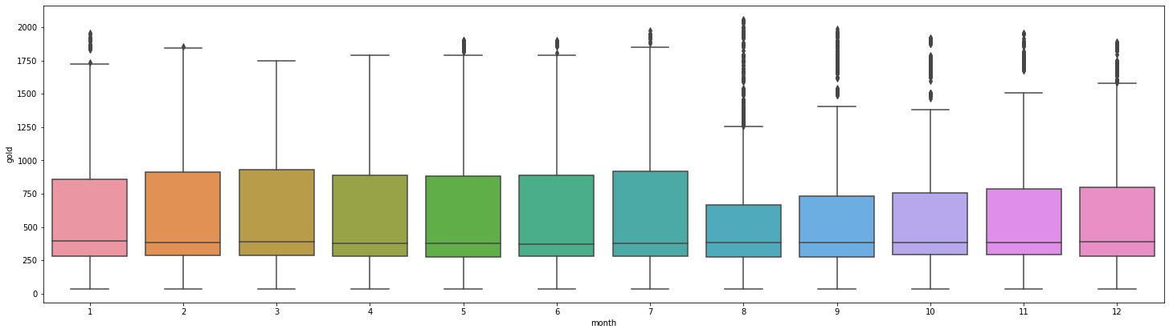

Slide 12
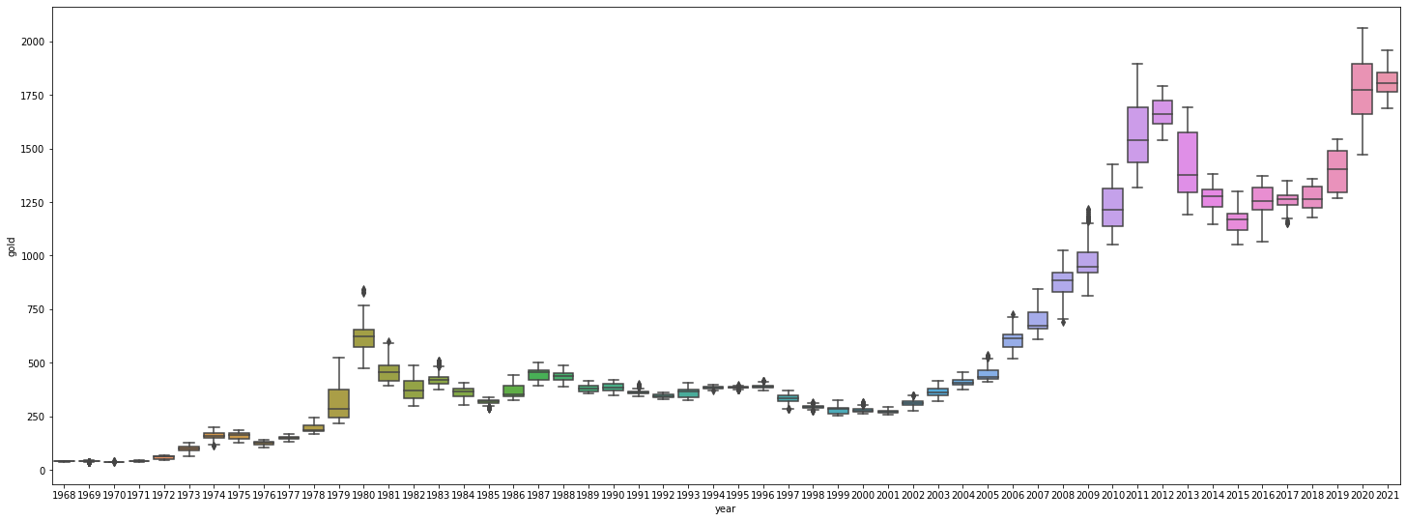

Slide 13
We had used following technical indicators which we felt help as a feature for prediction of Gold price
1. MACD : The moving average convergence-divergence (MACD) is one of the most powerful and well-known indicators in technical analysis. The indicator is comprised of two exponential moving averages that help measure momentum in a security. The MACD is simply the difference between these two moving averages plotted against a centerline, where the centerline is the point at which the two moving averages are equal.
2. RSI : The relative strength index (RSI) is another well known momentum indicators that’s widely used in technical analysis. The indicator is commonly used to identify overbought and oversold conditions in a security with a range between 0 (oversold) and 100 (overbought).
3. Simple Moving Average (SMA) : simply takes the sum of all of the past closing prices over a time period and divides the result by the total number of prices used in the calculation. For example, a 10-day simple moving average takes the last ten closing prices and divides them by ten.
4. Upper Band
5. Lower Band
6. DIFFERENCE

Slide 14
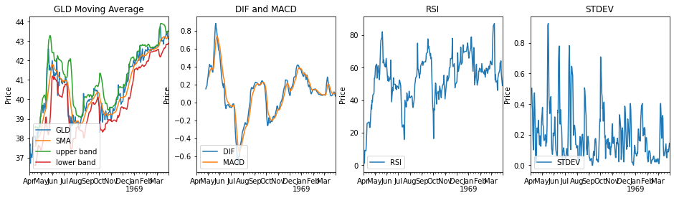

Slide 15
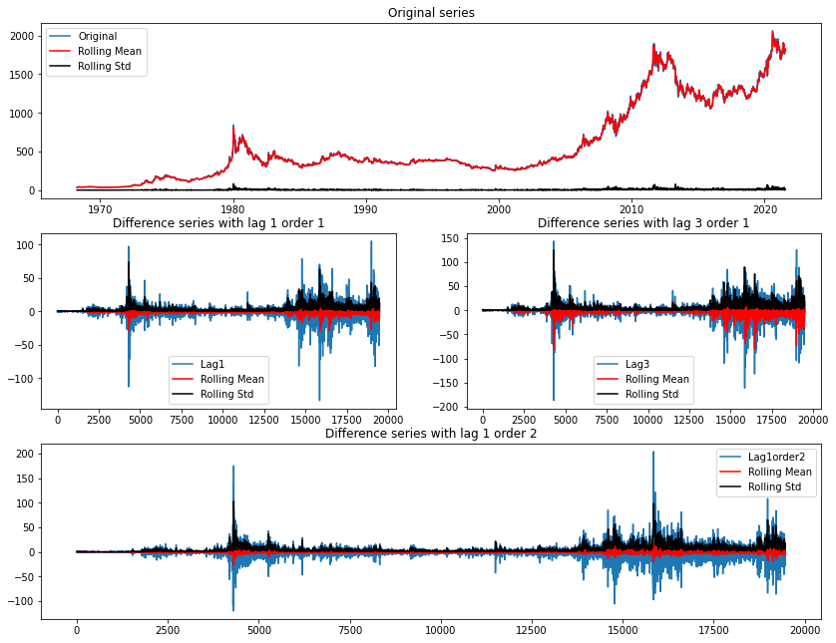
Difference plot

Slide 16
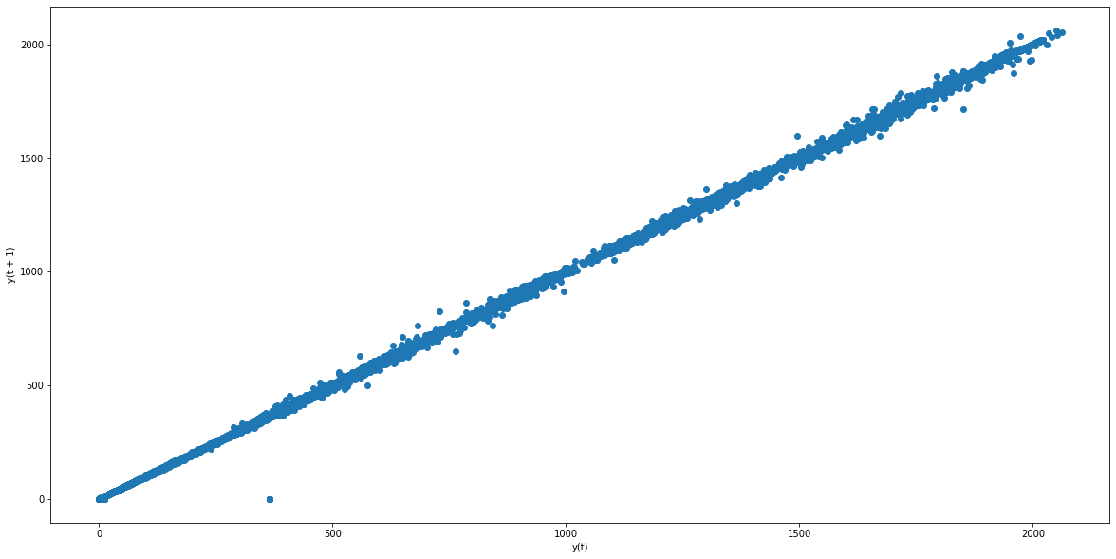
Lag-plot

Slide 17
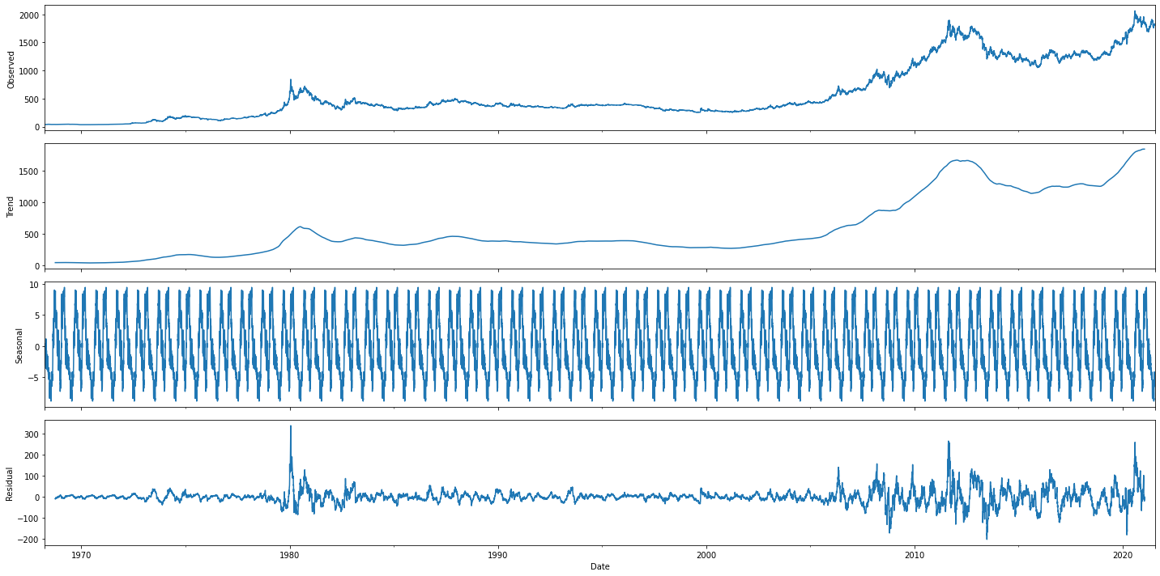
Stationarity analysis

Slide 18
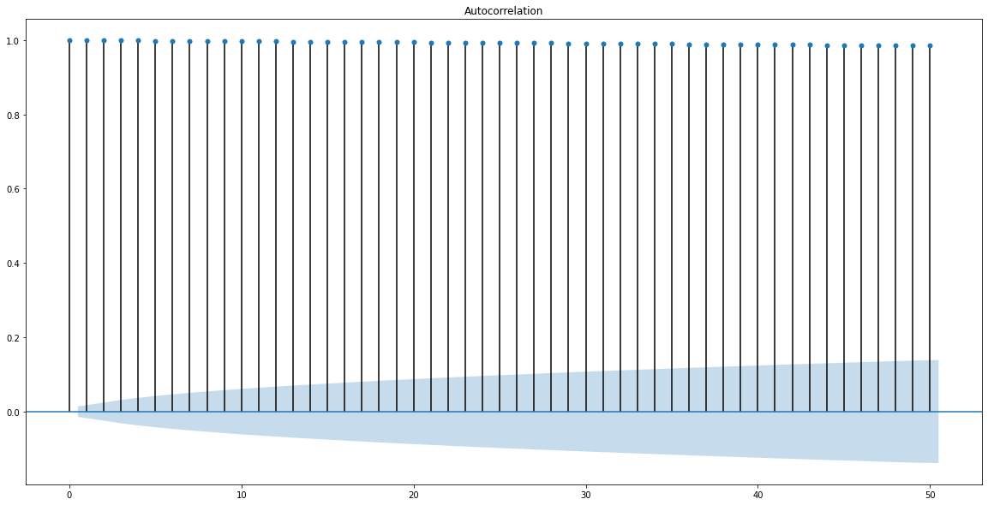
Acf Plot

Slide 19
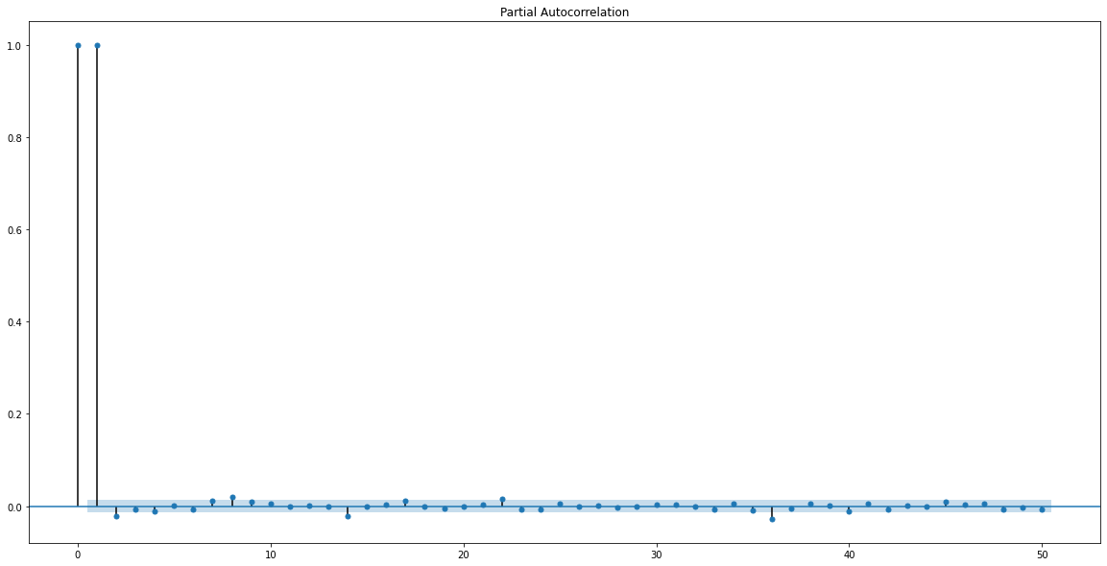
Pacf plot

Slide 20
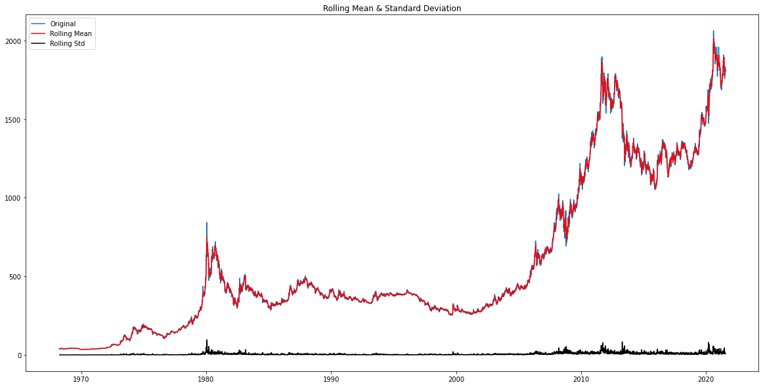
Rolling statistics

Slide 21
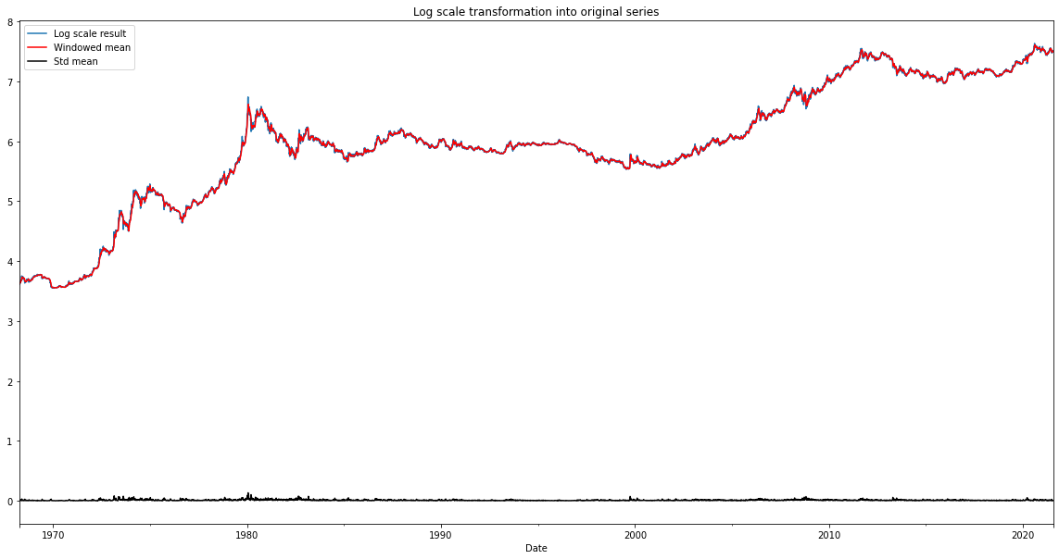

Slide 22
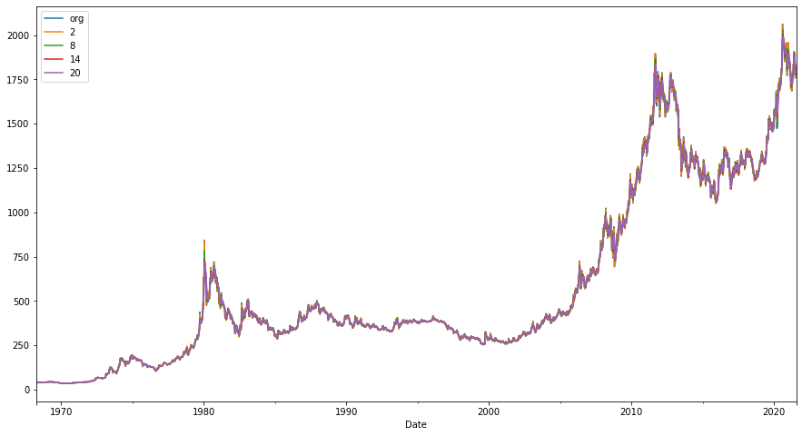
Smoothning of data

Slide 23
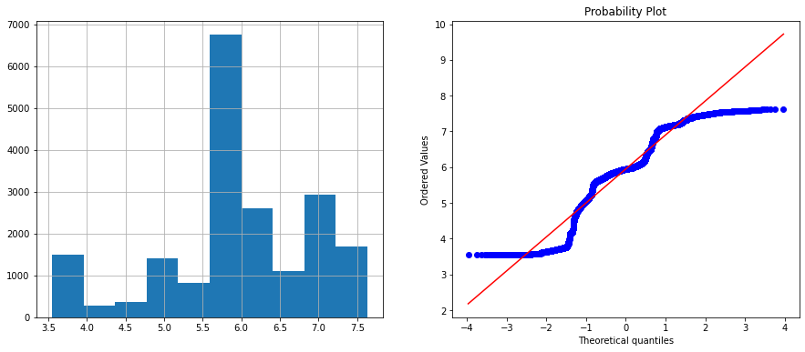
Data transformation plots
1) log

Slide 24
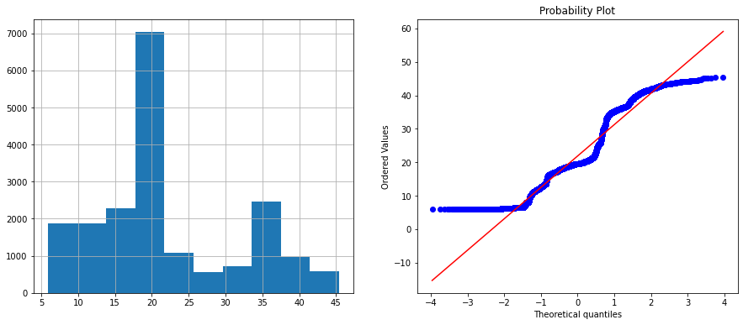
2) Square

Slide 25
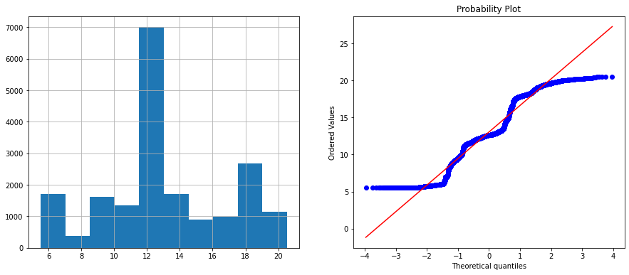
3)boxcox

Slide 26
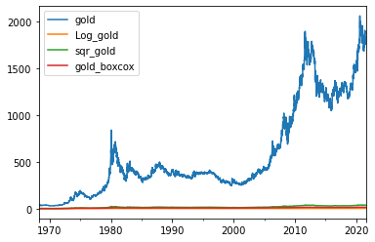
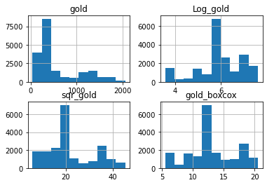
Comparision

Slide 27
Exploratory data analysis
The data has been treated with all the null values
The missing dates has been restored by datetime program
The data set is further subjected to the tests testing for stationarity or nan-stationarity

Slide 28
Dicky fuller test analysis
Results of Dickey-Fuller Test: p-value = 0.9983. The series is likely non-stationary. Test Statistic 1.772208 p-value 0.998292 #Lags Used 19.000000 Number of Observations Used 15556.000000 Critical Value (1%) -3.430770 Critical Value (5%) -2.861726 Critical Value (10%) -2.566869

Slide 29
eda
Data is fount to be non-stationarity in nature
The models with data set can be tested are with
Linear Regression
ARIMA
Arma

Slide 30
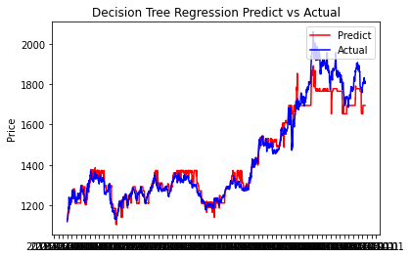
Model building
1)Benchmark Model: Will use Decision Tree Regressor with default parameter as Benchmark model
RMSE: 58.03450177411975
R2 score: 0.941491465057251

Slide 31
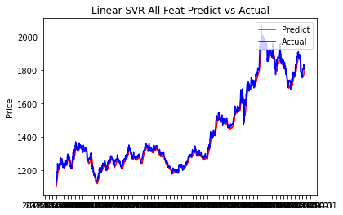
Support Vector Regressor (SVR)
RMSE: 0.8136995579158872
R2 score: 0.8474969071832203

Slide 32
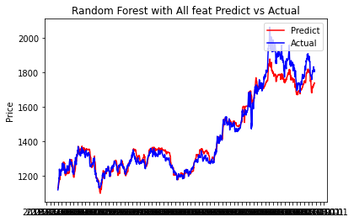
Random Forest
RMSE: 48.63854425273055
R2 score: 0.958903215899197

Slide 33
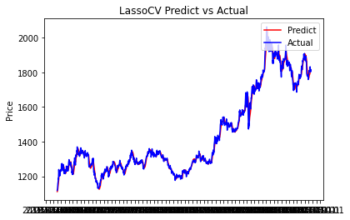
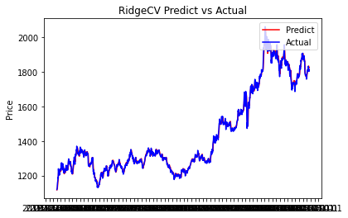
Lasso and Ridge Model
RMSE: 18.323580934523136
R2 score: 0.9941673300185231
RMSE: 13.679082464005495
R2 score: 0.9967494216526905

Slide 34

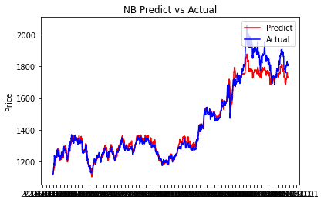
Bayesian Ridge and Gradient Boosting Regressor
RMSE: 13.661820568042506
R2 score: 0.9967576204103973
RMSE: 48.43604876111883
R2 score: 0.9592446977602528

Slide 35
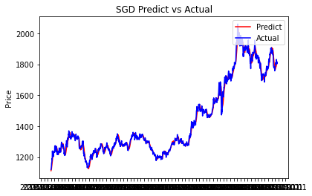
Stochastic Gradient Descent (SGD)
RMSE: 20.072166389413677
R2 score: 0.9930010127946113

Slide 36
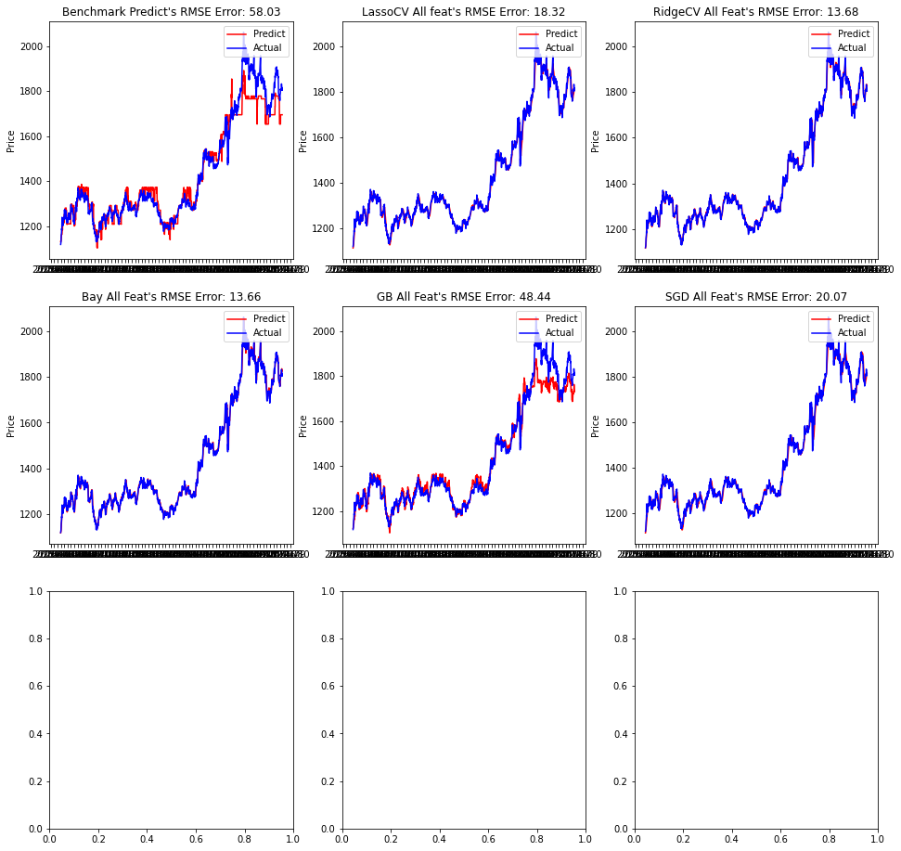

Slide 37
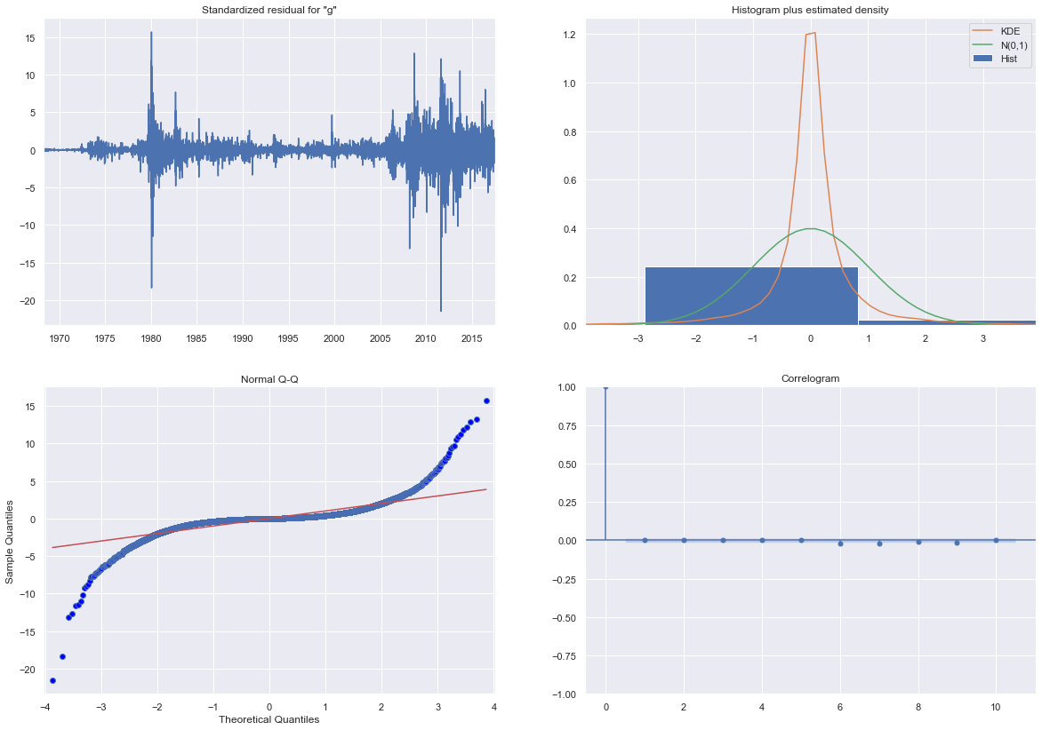
Auto SARIMA Model

Slide 38
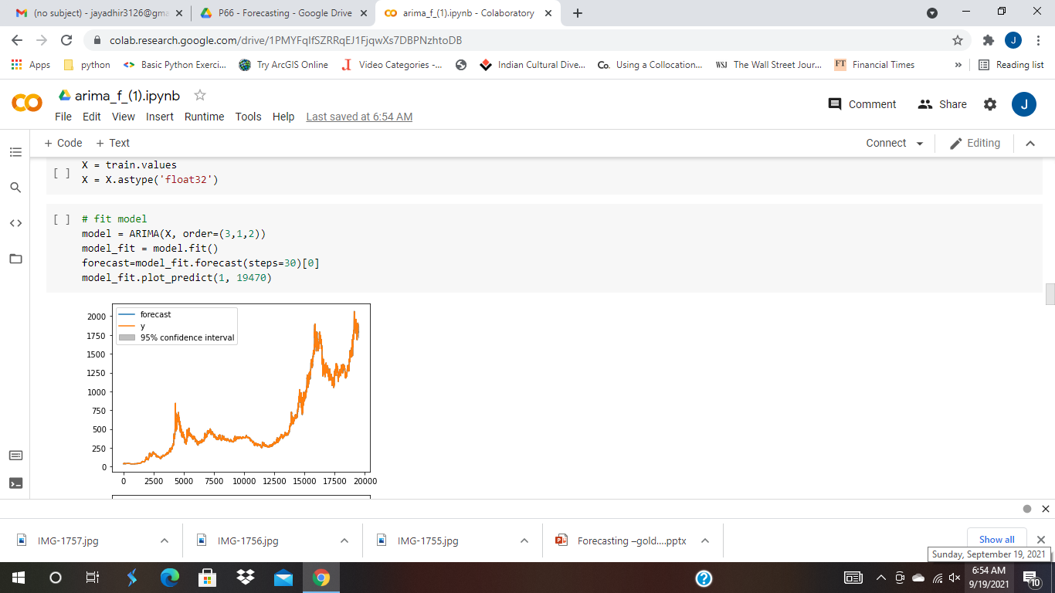
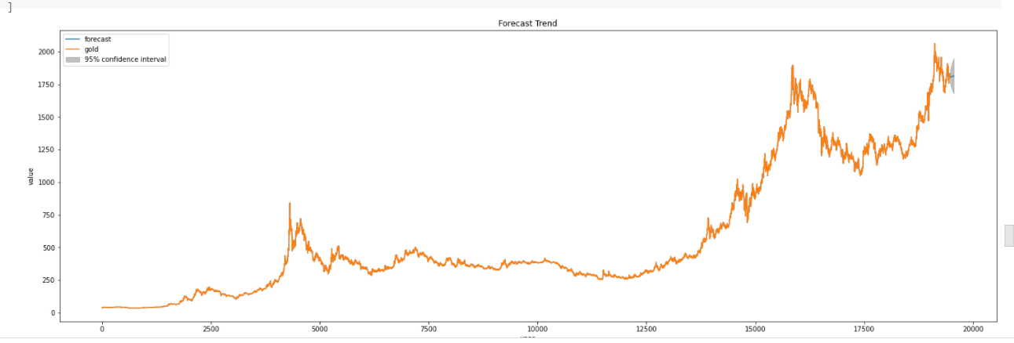
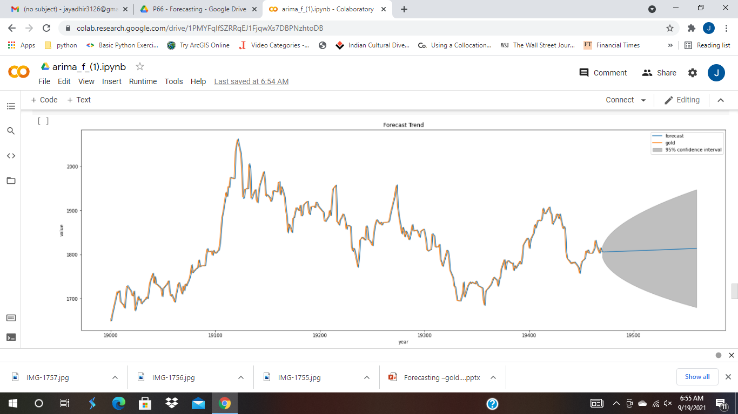
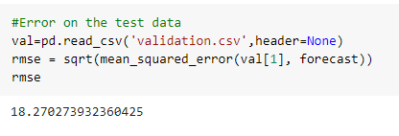
Arima Model

Slide 39
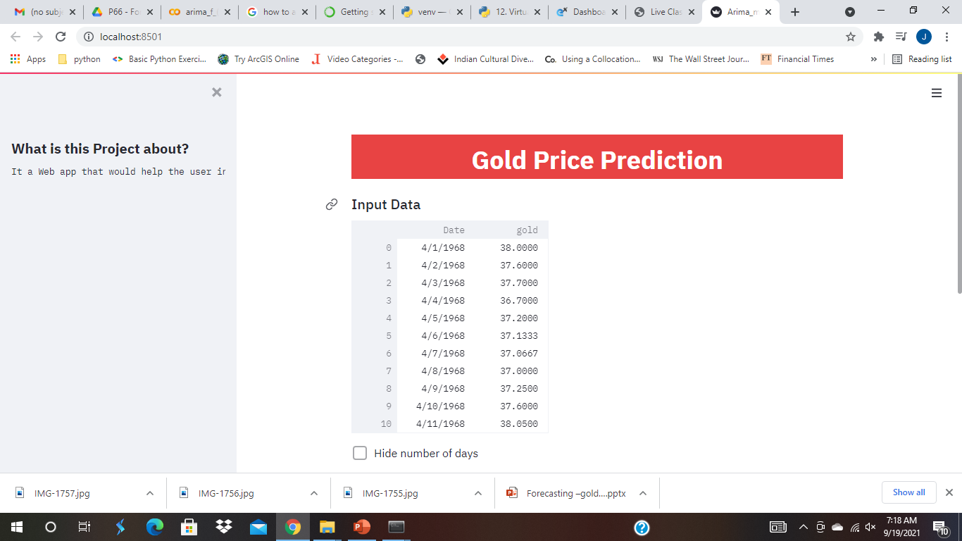
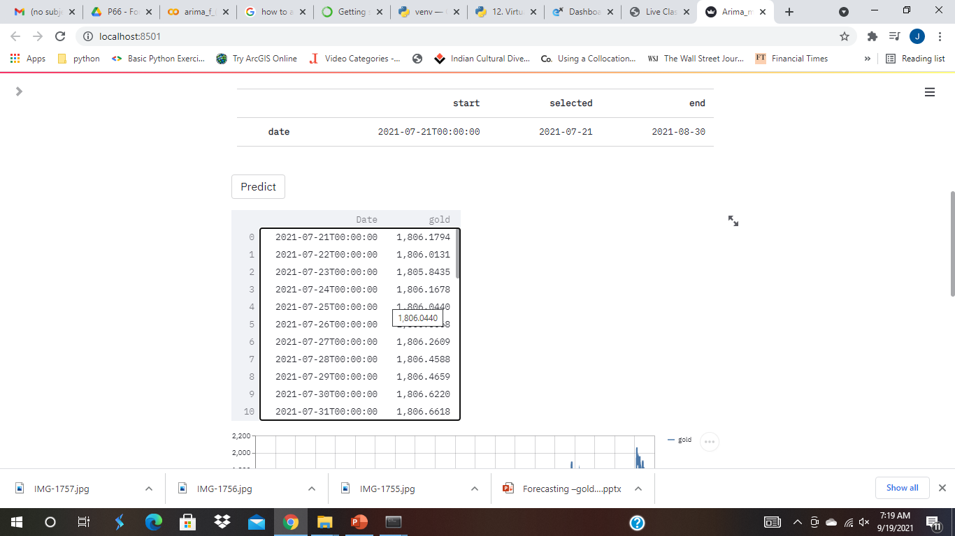
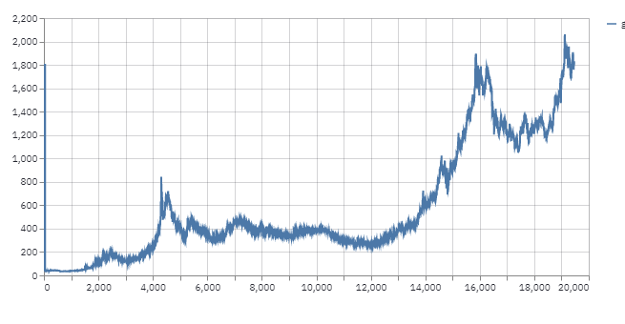
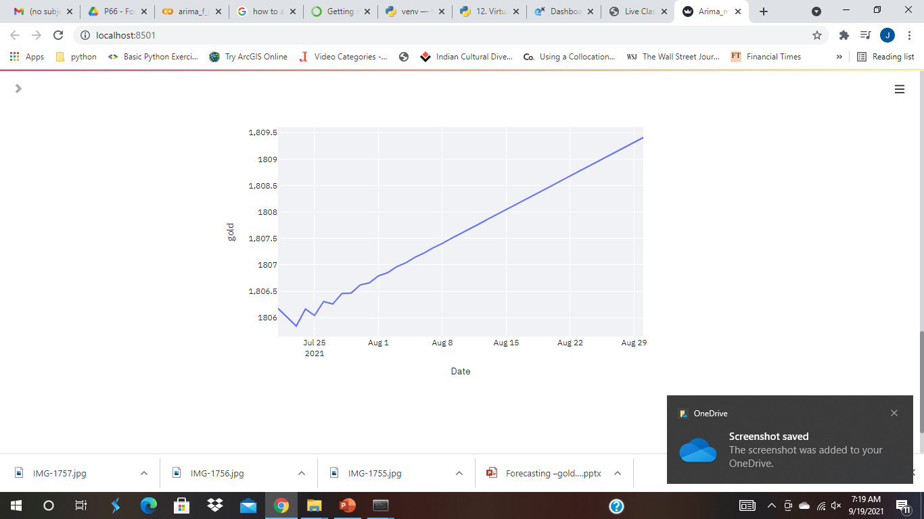
Deployment

Slide 40
Thank You

